Slide 1
This is how Text renders when we add text to the images (18)
This is how Text Renders when we add … (24)
This is how text Renders when (32)
This is how Text renders when we add text to the images (14)

Slide 2
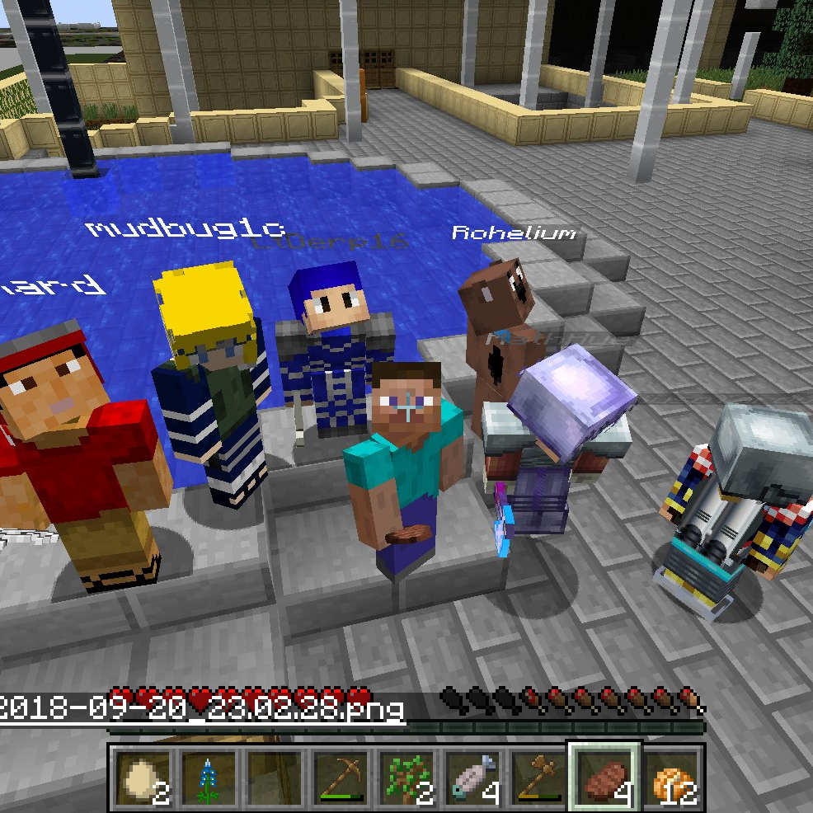
Using a Knockback Bomb (KBB)

